Slide 1

Problem Solving Using Computer
Course Code: BCAC 0018
Lecture - 3
Course: BCA I Year I Semester
By: Mr. Sanjiv Agrawal
Sanjiv.agrawal@gla.ac.in
+91-8923015116

Slide 2
The Computer Generations
“Generations” in computer talk is a step in technology.
Originally the term ‘generation’ was used to distinguish between varying hardware technologies. However, nowadays, it has been extended to include both hardware and software, which together make up an entire computer system.

Slide 3
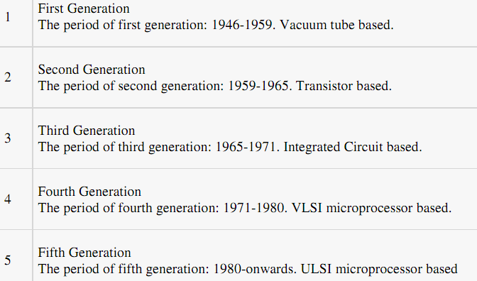
Generation of Computers

Slide 4
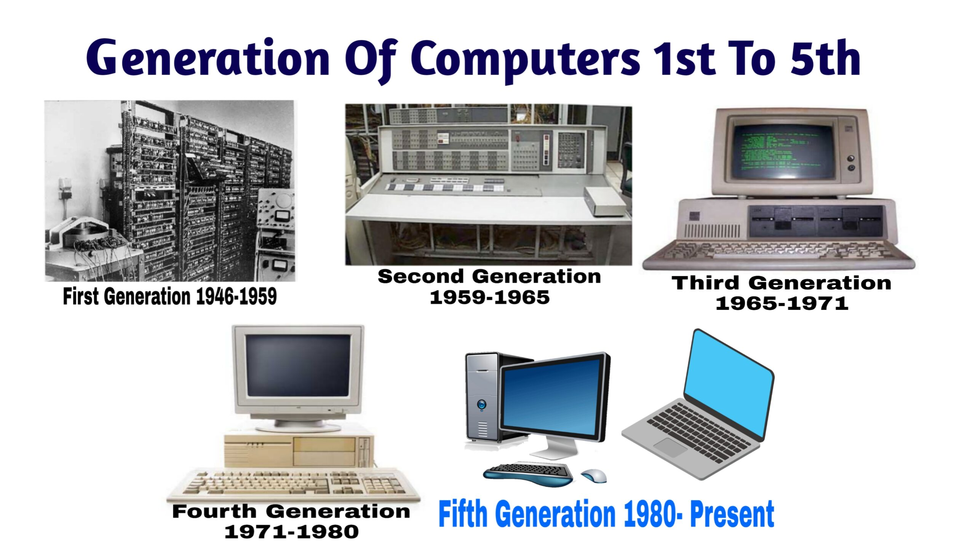

Slide 5
First Generation (1946 to 1959):
Using Vacuum Tubes
The first generation of computers used vacuum tubes for circuitry and magnetic drums for memory.
The input (data and instructions) to the computer was through punched cards and paper tapes.
The output was displayed as printouts.
The instructions were written in machine language.
Machine language uses 0s and 1s for coding of the instructions.
The first generation computers could solve one problem at a time.
These computers were very big in size and required a large room for installation.

Slide 6
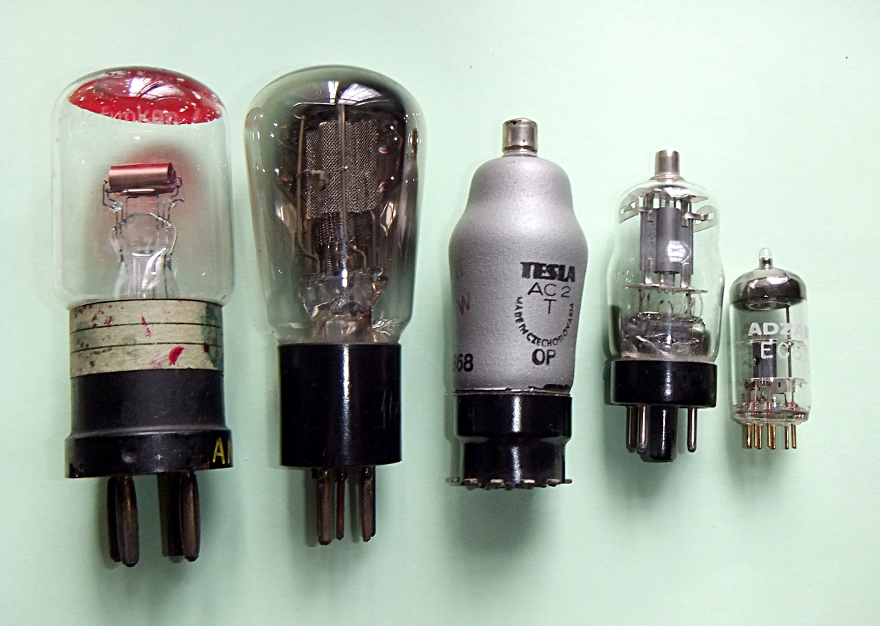
Vacuum Tubes

Slide 7
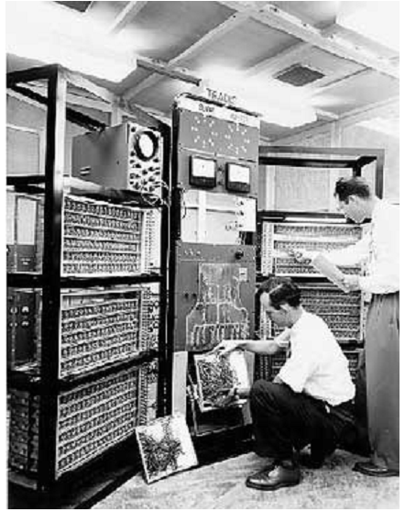

Slide 8
Examples
UNIVersal Automatic Computer (UNIVAC),
Electronic Numerical Integrator And Calculator (ENIAC), and
Electronic Discrete Variable Automatic Computer (EDVAC).

Slide 9
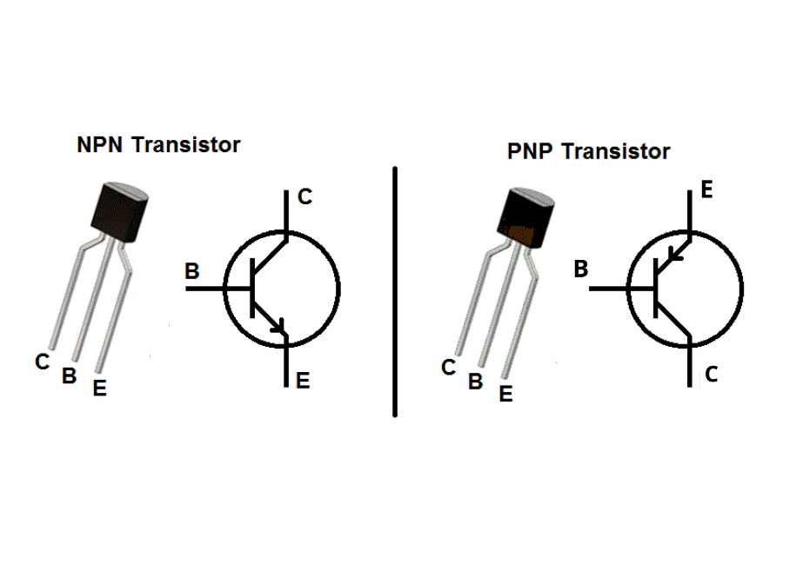
Second Generation (1959 to 1965):
Using Transistors
Transistors replaced the vacuum tubes of the first generation of computers.
Transistors allowed computers to become smaller, faster, cheaper, energy efficient and reliable.
They used magnetic tapes and magnetic disks for secondary storage.
The input was still through punched cards and the output using printouts.

Slide 10
They used the concept of a stored program, where instructions were stored in the memory of computer.
The instructions were written using the assembly language.
Assembly language uses mnemonics like ADD for addition and SUB for subtraction for coding of the instructions.
High level programming languages like FORTRAN, COBOL, ALGOL, and SNOBOL were developed during the second-generation periods.
PDP-8, IBM 1401 and CDC 1604.

Slide 11
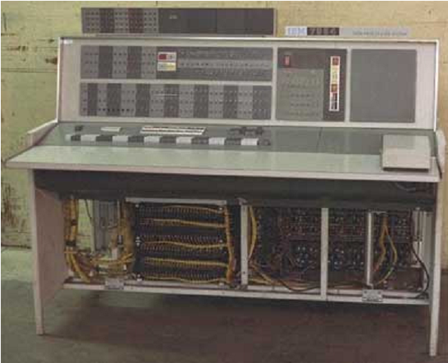

Slide 12
The first generation computers were mainly used for scientific computations.
However in the second generation, an increasing usage of computers was seen in business and industries for commercial data processing applications like payroll, inventory control, marketing, and production planning.

Slide 13
Third Generation (1965 to 1971):
Using Integrated Circuits
The third generation computers used the Integrated Circuit (IC) chips.
Integrated Circuits are circuits consisting of several electronic components like transistors, resistors, and capacitors grown on a single chip of silicon, eliminating wired interconnection between components.
The IC technology was also known as “microelectronics” technology because it made it possible to integrate larger number of circuit components into very small (less then 5 mm square) surface of silicon, know as “chip”.
The use of IC chip increased the speed and the efficiency of computer, very much.

Slide 14
Initially the integrated circuits contained only about ten to twenty components . This technology was named small scale integration (SSI). Later, with the advancement in technology for manufacturing ICs, it become possible to integrate up to about hundred components on a single chip. This technology was came to be known as medium scale integration (MSI).
The keyboard and monitor were used to interact with the third generation computer, instead of the punched card and printouts.
High-level languages were used extensively for programming, instead of machine language and assembly language.
FORTRON and COBOL were standardized by American National Standard Institute (ANSI).
Additionally, some more high level programming languages were introduced during the third generation period. Notable among these were PL/1, PASCAL and BASIC.
IBM 370, PDP 11.

Slide 15
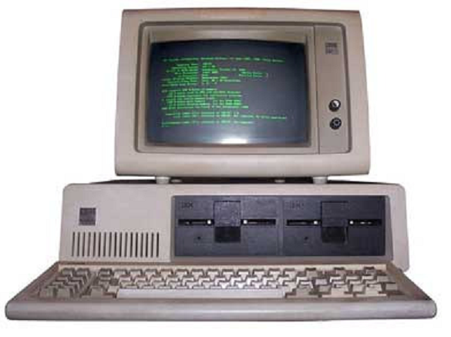

Slide 16
Fourth Generation (1971 to 1980):
Using Microprocessors
They use the Large Scale Integration (LSI) and the Very Large Scale Integration (VLSI) technology.
Thousands of transistors are integrated on a small silicon chip using LSI technology.
VLSI allows hundreds of thousands of components to be integrated in a small chip, called microprocessor.
Microprocessor is a chip containing millions of transistors and components, and, designed using LSI and VLSI technology.

Slide 17
A Microprocessor contains all the circuits needed to perform arithmetic, logic and control function, the core activities of all the computers, on a single chip. Hence, it become possible to build a complete computer with a microprocessor, a few additional primary storage chips, and other support circuitry.
It started a new social revolution – the Personal Computer (PC) revolution.
Magnetic core memories were replaced by semiconductor memories, resulting in large random access memories with very fast access time. On the other hand, hard disk become cheaper, smaller, and larger in capacity.

Slide 18
Another significant development during the fourth-generation period was the spread of high-speed computer networking, which enabled multiple computers to be connected together, to enable them to communicate and share data.
The computers were linked to form networks that led to the emergence of the Internet.
Several new operating systems like the MS-DOS and MS-Windows, and Apple’s proprietary OS developed during this time.
This generation of computers supported Graphical User Interface (GUI).
GUI is a user-friendly interface that allows user to interact with the computer via menus and icons.
The UNIX operating system and the C programming language also become very popular.

Slide 19
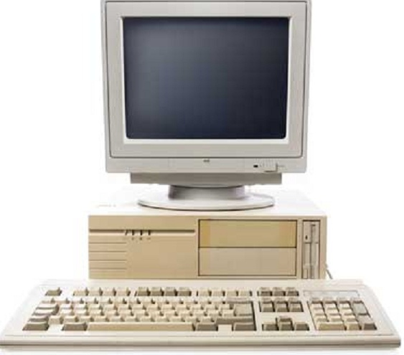

Slide 20
Fifth Generation (1980 Onwards..):
Using Artificial Intelligence
The goal of fifth generation computing is to develop computers that are capable of learning and self-organization.
The fifth generation computers use Ultra Large Scale Integrated (ULSI) chips that are able to store millions of components on a single chip.
This generation of computers uses parallel processing that allows several instructions to be executed in parallel, instead of serial execution.
Parallel processing results in faster processing speed.
The fifth generation computers are based on Artificial Intelligence (AI).
They try to simulate the human way of thinking and reasoning.

Slide 21
